Slide 1






SKR
SATTVA KRUSHI
RASAYAN

Slide 2




02
SKR
What are the topics we are not
chosen?
List of Considered Topics:
Hostel Management System
Pet Shop App
Apartment Management System
Attendance System App
Agro-based E-commerce (Selected Topic)

Slide 3


03
SKR
1. Hostel Management System
Pros:
Streamlined Operations: Efficient management of hostel activities.
Easy Communication: Direct communication between staff and residents.
Automation: Room allocation and fee management.
Cons:
Limited Scalability: Restricted to hostel management only.
High Development Cost: Significant upfront investment.
Maintenance: Requires continuous updates and support.

Slide 4

04
SKR
2. Pet Shop App
Pros:
Personalized Care: Tailored recommendations for pets.
Convenience: Easy online shopping and service booking.
Loyalty Rewards: Incentives for repeat business.
Cons:
Competition: Intense market rivalry.
Logistics: Complicated delivery and inventory management.
Regulations: Strict compliance requirements for live animals.

Slide 5

05
SKR
3. Apartment Management System
Pros:
Centralized Control: Simplifies apartment operations.
Automated Processes: Fee collection and maintenance scheduling.
Better Communication: Connects tenants and management easily.
Cons:
Complex Setup: Integration with apartment systems.
Privacy Concerns: Data security issues.
Limited Appeal: Focused only on residential complexes.

Slide 6

06
SKR
4. Attendance System App
Pros:
Automates Tracking: Effortless attendance management.
Real-time Updates: Instant notifications for absences.
Accuracy: Reduces human error in record-keeping.
Cons:
LScalability: Works best for small to medium organizations.
Initial Cost: High setup and integration cost.
Dependency: Relies on stable internet connectivity.

Slide 7

07
SKR
5. Agro-based E-commerce (Selected Topic)
Pros:
Market Access: Expands reach for farmers and buyers.
Convenience: Easy and quick access to agricultural products.
Secure Payments: Multiple payment options, including COD.
Real-time Tracking: Users can track orders and deliveries.
Cons:
Logistics: Challenges with rural delivery.
Digital Literacy: Users need basic tech skills.

Slide 8

08
SWOT Analysis of Our App
SKR
Strengths
Weaknesses
Expands market reach for farmers and Customer.
Provides service with easy
online transactions.
Minimizes middleman involvement.
High competition in the e-commerce space.
Challenges in logistics for rural areas.
Requires digital education among users.

Slide 9
09
SWOT Analysis of Our App
SKR
Opportunities
Threats
Growing demand for online agricultural products.
increase into new markets and Area.
Partnerships with local delivery networks.
Change in agricultural product availability.
Cybersecurity risks and data privacy concerns.
Potential regulatory changes in agriculture.

Slide 10

10
SKR
Features of Agro-based E-commerce App
01
Product Listings : Detailed product information with images.
02
Order Management : Easy order placement and tracking.
03
Secure Payment Gateway : Multiple payment options including cash on delivery.
04
Real-time Updates : Order status, delivery tracking, and notifications.
05
Loyalty Programs : Discounts.
06
User Reviews and Ratings : Allows customers to leave feedback on products and services, helping others make informed decisions.

Slide 11

11
SKR
Why We Need this Project ?
Here are some key reasons why the Agro-based
E-commerce app is needed :
Improves Market Access: Connects farmers directly with Customer, reducing middlemen.
Increases Efficiency: saving time and costs for all.
Supports Small Farmers: Empowers small-scale farmers with general market reach.
Promotes Transparency: Clear cost and product info for informed decisions.
Enhances Customer facility: Shop from anywhere with secure payments and home delivery.

Slide 12

12
SKR
Ninjacart:
A B2B platform connecting farmers directly with retailers, restaurants, and other businesses, ensuring fresh produce reaches the market quickly and efficiently.
AgriBazaar:
Platforms like Our App.
An online marketplace that allows farmers to sell their produce directly to buyers across India, offering a wide range of agricultural products.
Agristar:
A comprehensive platform providing farmers with access to agricultural inputs, personalized advisory services, and direct market linkages for selling their produce.
Kisan Network:
A digital marketplace where farmers can sell their produce directly to buyers, cutting out middlemen and ensuring better prices for their crops.

Slide 13


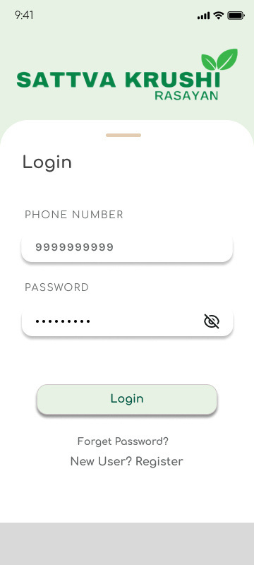
13
03
SKR
Wireframes
Splash Screen
Landing Page
Login Page

Slide 14
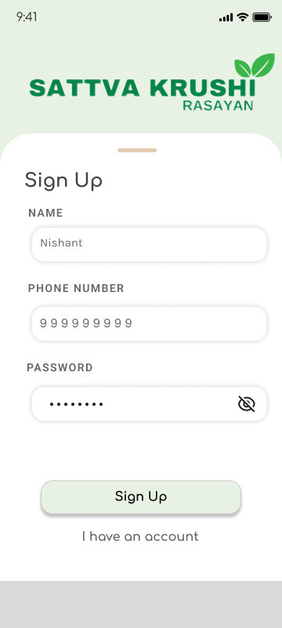
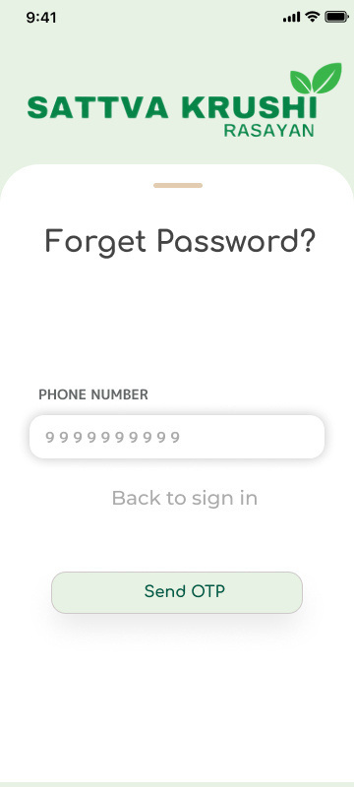
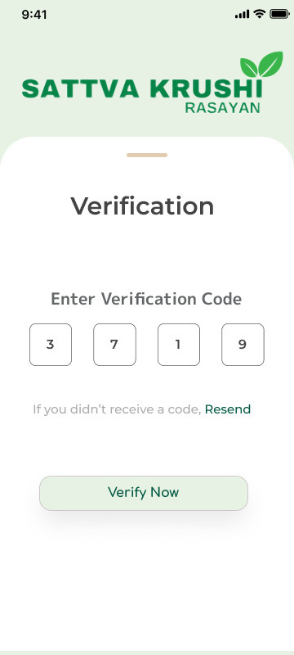
14
03
SKR
Wireframes
Singup screen
Forget password
Verification

Slide 15
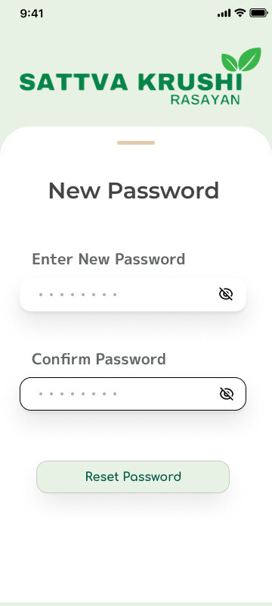
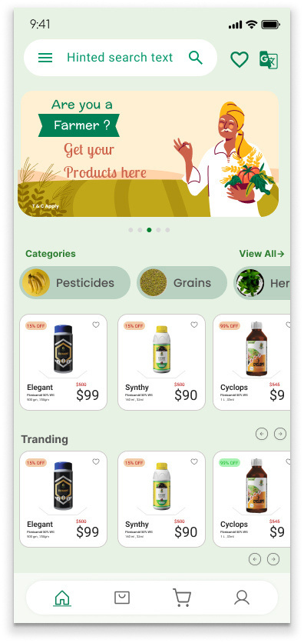
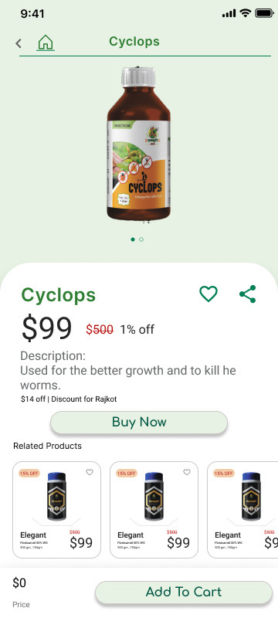
15
03
SKR
Wireframes
New Password
Home Screen
Detail Screen

Slide 16
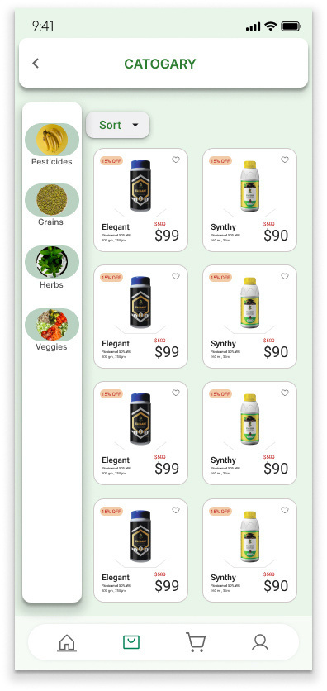
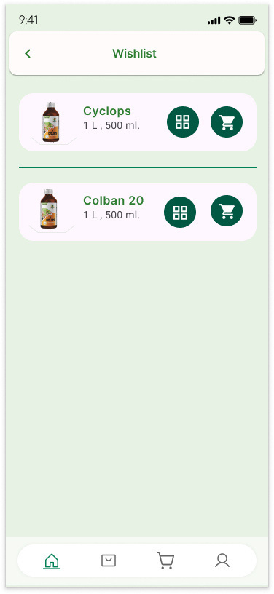
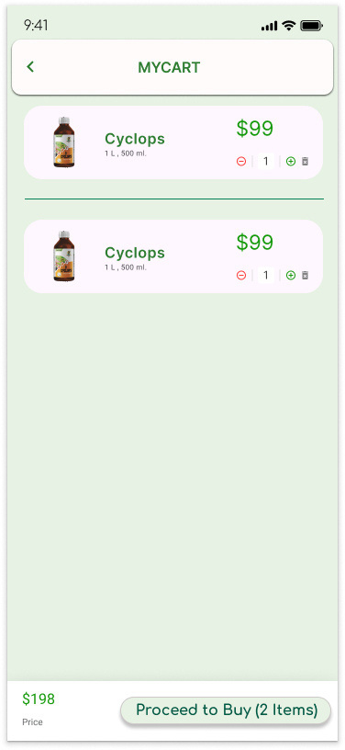
16
03
SKR
Wireframes
Category Screen
Wish List Screen
Cart Screen

Slide 17
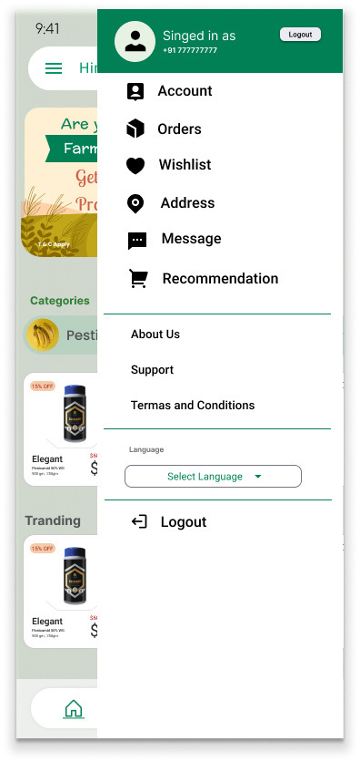
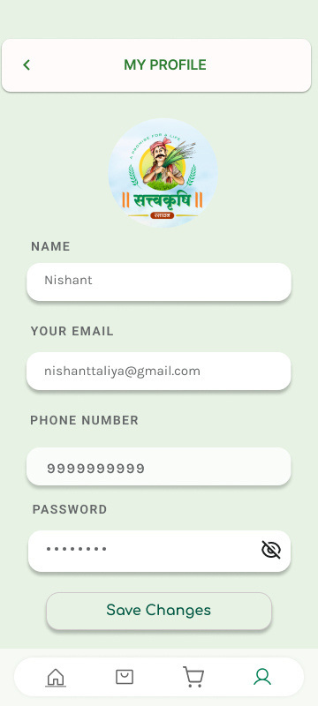
17
03
SKR
Wireframes
Menu Bar
Profile Screen

Slide 18
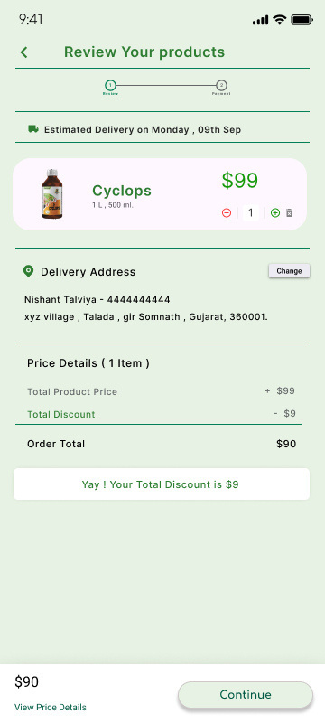
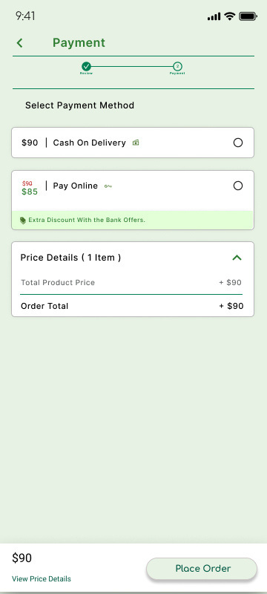
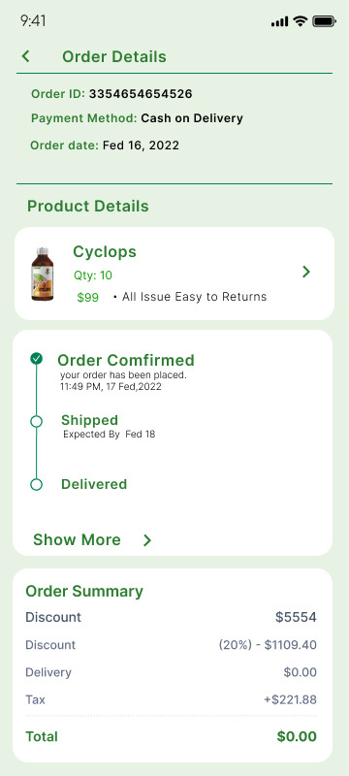
18
03
SKR
Wireframes
Product Review Screen
Payment Screen
Order Detail Page

Slide 19
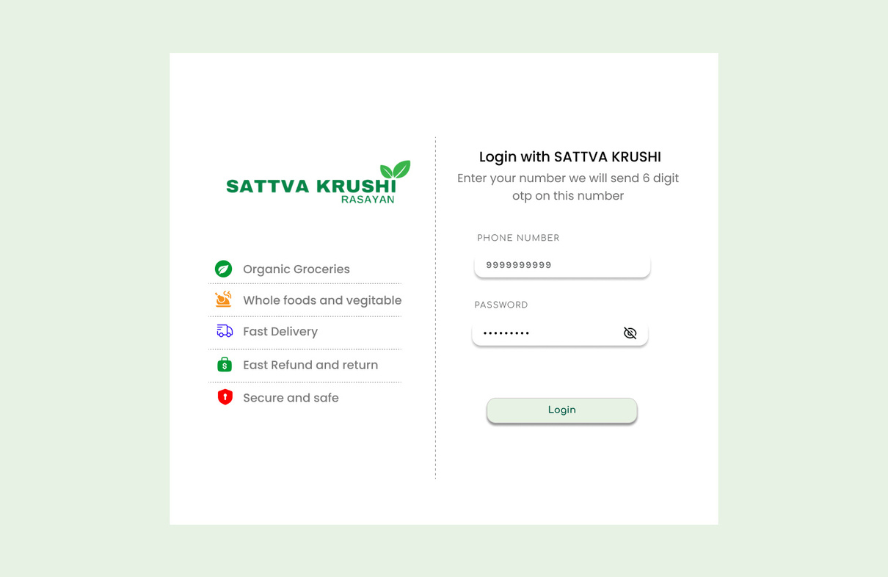
19
03
SKR
Wireframes
Admin Panel Screens
Login Screen

Slide 20
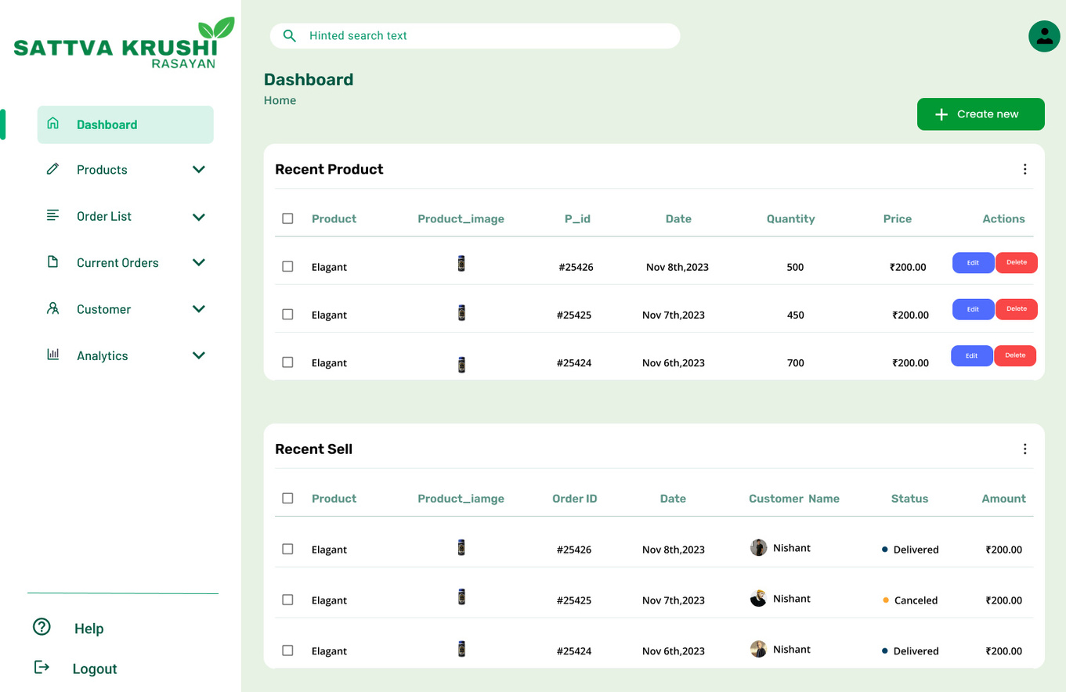
20
03
SKR
Wireframes
Admin Panel Screens
Dashboard Screen

Slide 21
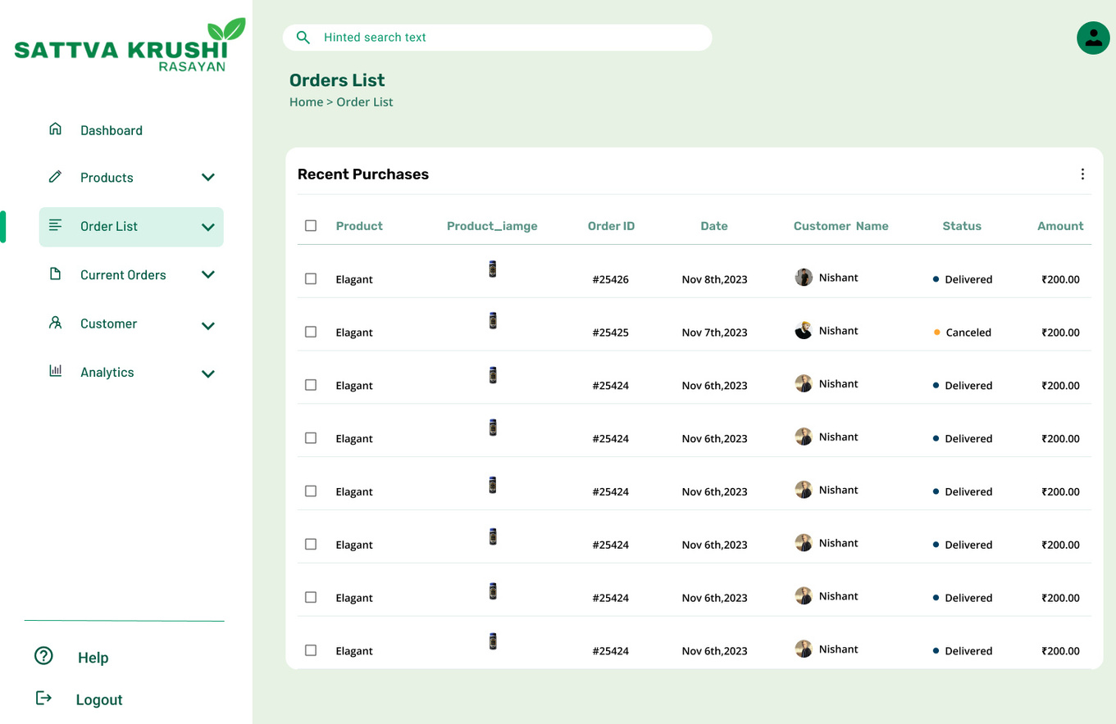
21
03
SKR
Wireframes
Admin Panel Screens
Order List Screen

Slide 22
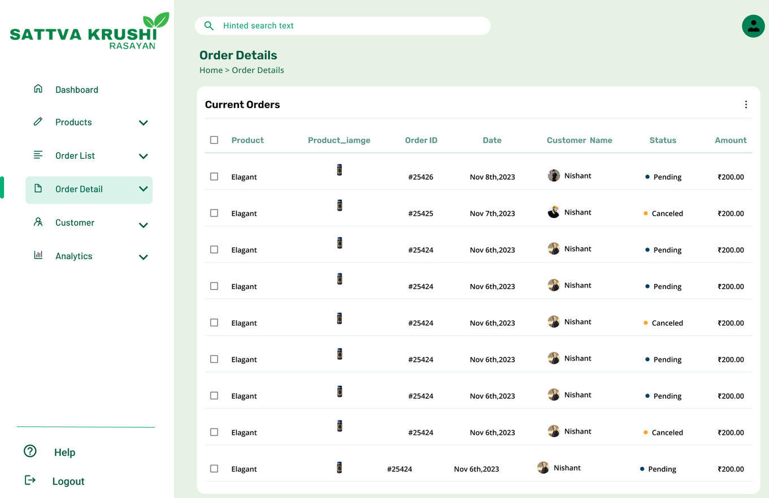
22
03
SKR
Wireframes
Admin Panel Screens
Current Order Screen

Slide 23
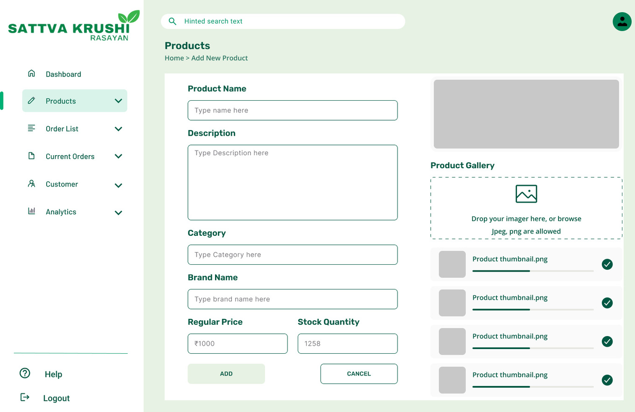
23
03
SKR
Wireframes
Admin Panel Screens
Product Add Screen

Slide 24
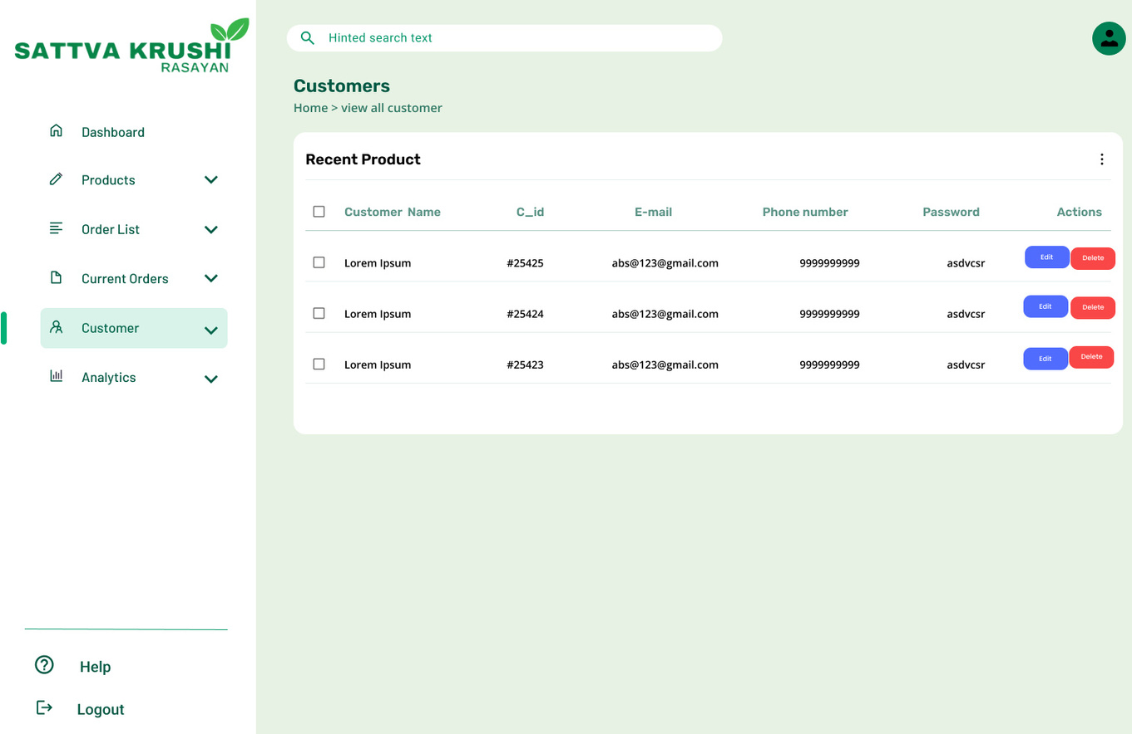
24
03
SKR
Wireframes
Admin Panel Screens
Customer Screens

Slide 25

25
RADHESH JOSHI
Our Team Members
NISHANT TALIVIYA
VAIBHAV GORIYA

Slide 26


SKR
Thank You!

